Slide 1

Project -II
PROJECT REVIEW -1

Slide 2
Department of Electronics Engineering Lane Following Mobile Robot
Team Members
Chinmay Bhoir (TU1F1819006)
Mahendra Gudla (TU1F1819009)
Suchita Boga (TU1S1920004)
Sandhya Yadav (TU1S1920008)
Project Guide: Project Coordinator:
Mr. Vijaykumar Chaudhari Mrs. Renuka Chimankare

Slide 3
Main Modules
Raspberry Pi module
Camera module
Arduino module
Motor Driver module
Bluetooth module

Slide 4
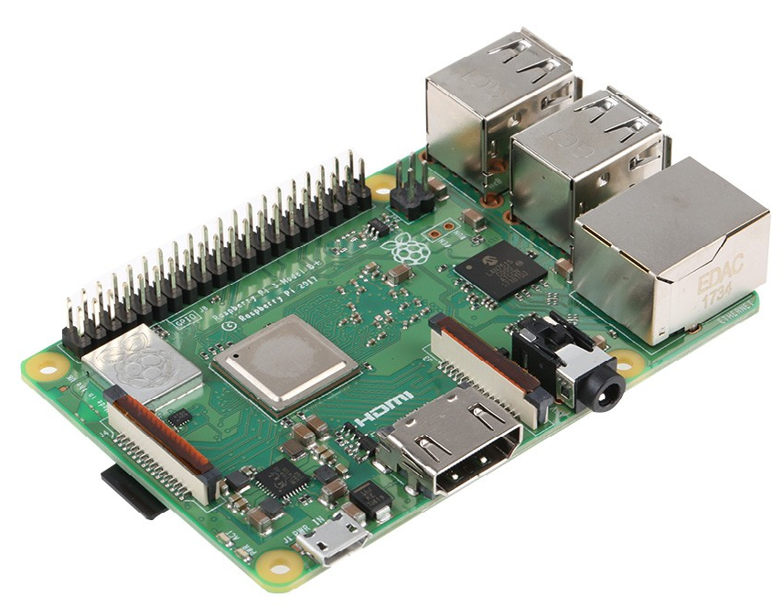
Raspberry Pi Module
 | Description
CPU | Cortex-A53 (ARMv8) 64-bit SoC @ 1.4GHz
RAM | 1GB LPDDR2 SDRAM
GPIO Header | Extended 40-pin
Wireless | 2.4GHz and 5GHz IEEE 802.11.b/g/n/ac wireless LAN, Bluetooth 4.2, BLE
Ports | 4 USB 2.0 , Wired Ethernet up to 330 Mbps
Camera Port | CSI camera port for connecting a Raspberry Pi camera
Board Dimensions | 85 x 56 mm
Multimedia | 1080p30
Power Input | 5V/2.5A DC
Storage | Micro SD port for loading operating system and storing data
Output | 4-pole stereo output and composite video port

Slide 5
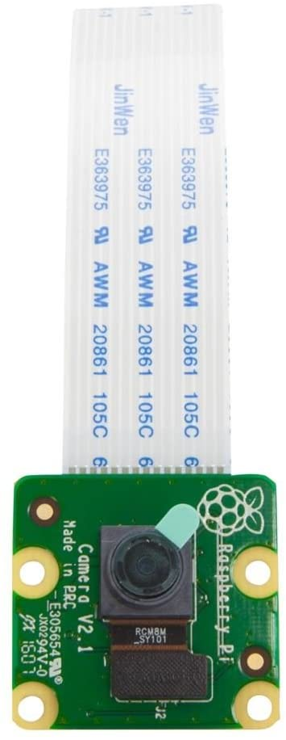
Camera Module
 | Description
Camera Module | 5 Megapixel Omnivision 5647 Camera Module
Photo Resolution | 2592 x 1944 Pixels
Video | 1080p @ 30fps, 720p @ 60fps and 640x480p 60/90
Size | 25mm x 23mm x 8mm
Weight | 3 grams
Camera Serial Interface | 15-pin MIPI (Plugs Directly into the Raspberry Pi Board)
Compatibility | Raspberry Pi Model A, Model B and Model B + Raspberry Pi

Slide 6
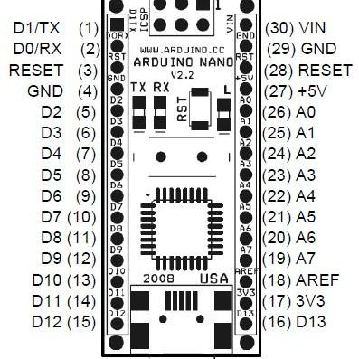
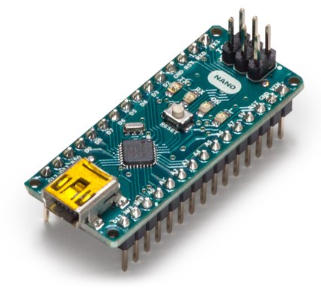
Arduino Nano module
 | Description
Microcontroller | ATMEGA328P
Architecture | AVR
Operating Voltage | 5V
Flash Memory | 32 KB of which 2KB used by Bootloader
SRAM | 2 KB
Clock Speed | 16 MHz
Analog in Pins | 8
EEPROM | 1 KB
DC Current per I/O Pins | 40 mA (I/O Pins)
Input Voltage | 7-12V
Digital I/O Pins | 22 (6 of which are PWM)
PWM Output | 6
Power Consumption | 19 mA
PCB Size | 18 x 45 mm

Slide 7
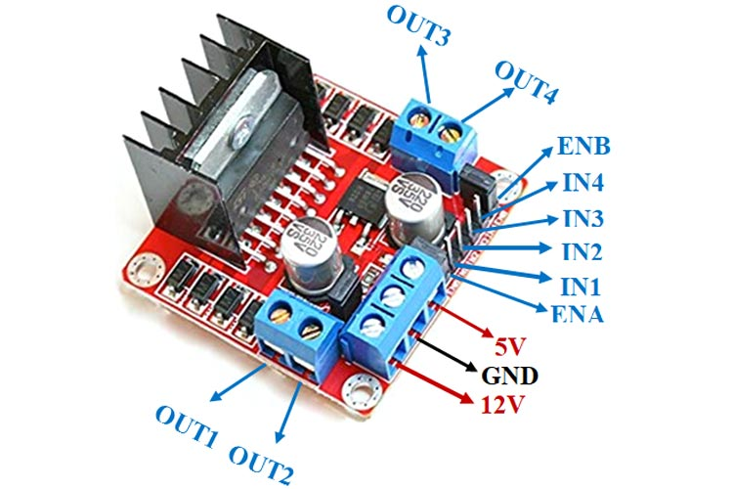
Motor Driver module
 | Description
Driver Module | L298N 2A
Driver Chip | Double H Bridge L298N
Motor Supply Voltage (Maximum) | 46V
Motor Supply Current (Maximum) | 2A
Logic Voltage | 5V
Driver Voltage | 5-35V
Driver Current | 2A
Logical Current | 0-36mA
Maximum Power (W) | 25W
Pin Name | Description
IN1 & IN2 | Motor A input pins. Used to control the spinning direction of Motor A
IN3 & IN4 | Motor B input pins. Used to control the spinning direction of Motor B
ENA | Enables PWM signal for Motor A
ENB | Enables PWM signal for Motor B
OUT1 & OUT2 | Output pins of Motor A
OUT3 & OUT4 | Output pins of Motor B
12V | 12V input from DC power Source
5V | Supplies power for the switching logic circuitry inside L298N IC
GND | Ground pin

Slide 8
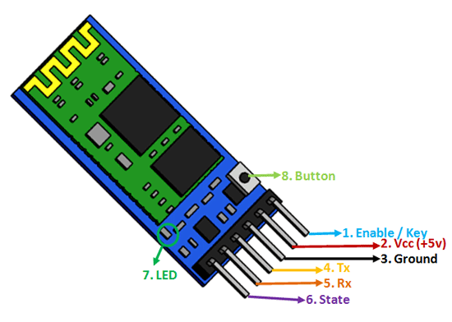
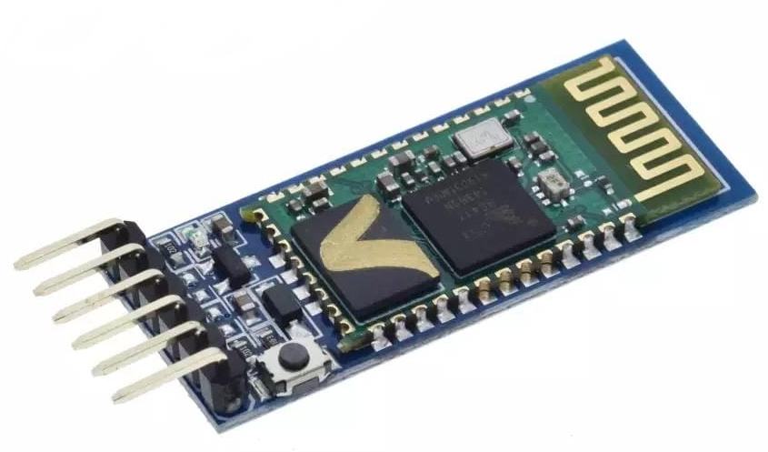
Bluetooth module
 | Description
Bluetooth protocol | Bluetooth Specification v2.0+EDR
Frequency | 2.4GHz ISM band
Modulation | GFSK(Gaussian Frequency Shift Keying)
Emission power | ≤4dBm, Class 2
Sensitivity | ≤-84dBm at 0.1% BER
Security | Authentication and encryption
Speed | Asynchronous – 2.1Mbps(Max)/160kbps Synchronous – 1Mbps/1Mbps
Profiles | Bluetooth serial port
Power supply | +3.3VDC 50mA
Dimension | 26.9mm x 13mm x 2.2 mm
Operating Voltage | 4V to 6V (Typically +5V)
Operating Current | 30mA
Range | : <100m

Slide 9
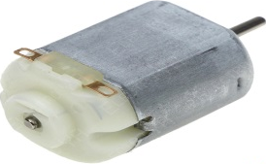
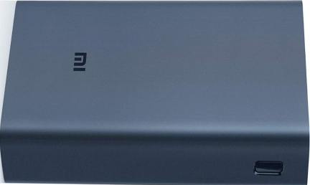
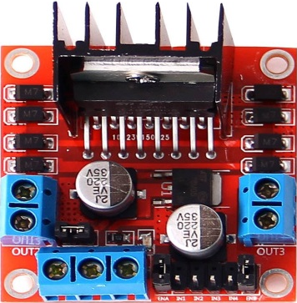
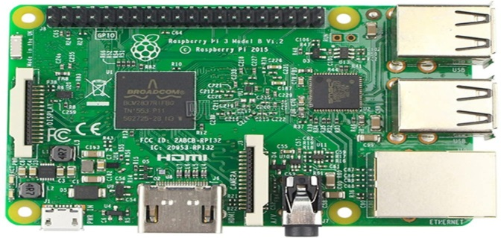
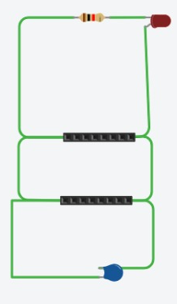
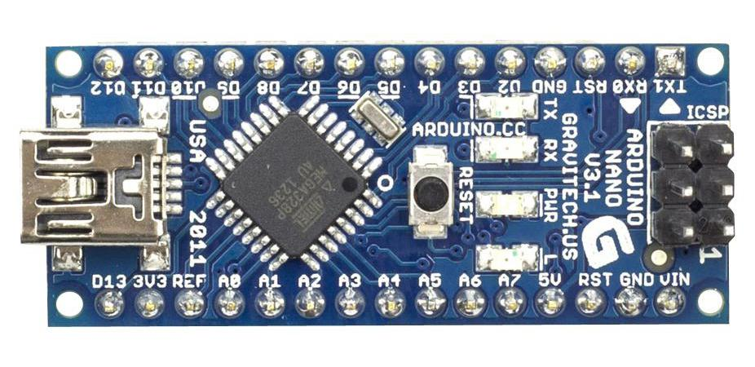


Methodology System Design
DC Motors
(Parallelly Connected)
Raspberry Pi Camera (5MP)
Power Bank (Power Supply)
Left motors
Right motors
5-12V
Sends Captured Image (Video Stream)
5-12V
L298N Motor Driver
Sends Required Instruction
Sends Processed Instruction
Bluetooth HC-05

Slide 10
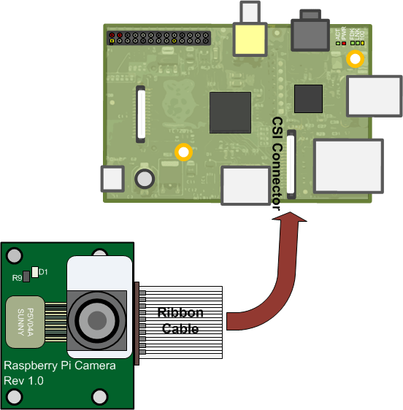
Raspberry Pi Camera Interfacing with Raspberry Pi

Slide 11
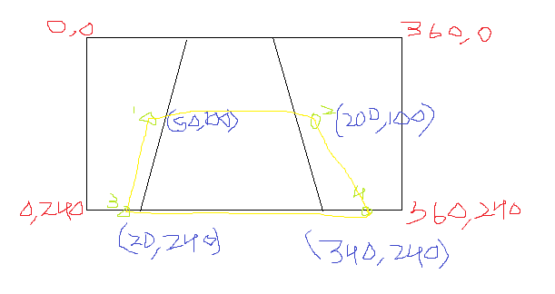
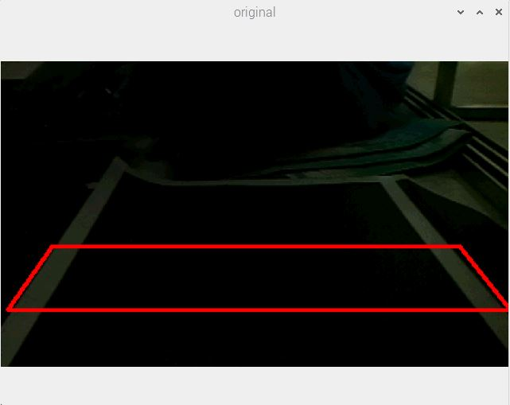
Planned Region of Interest
Original Image

Slide 12
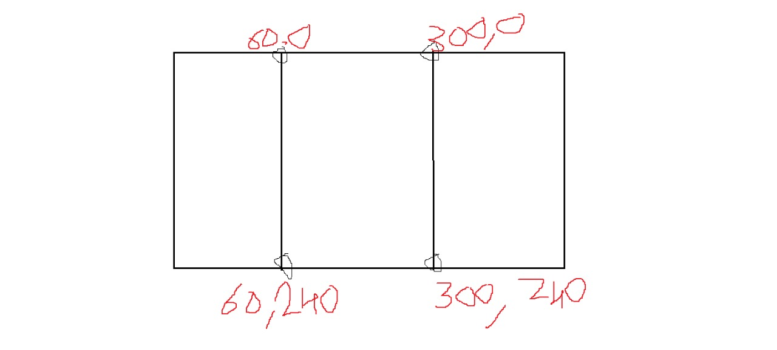
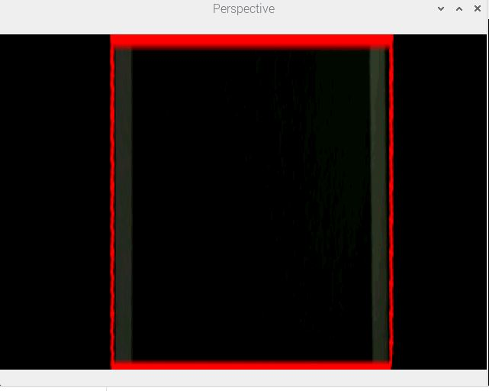
Perspective View
Transforms the image in a straight manner after Perspective Transformation is applied to it.
Expected Perspective View
Perspective View

Slide 13
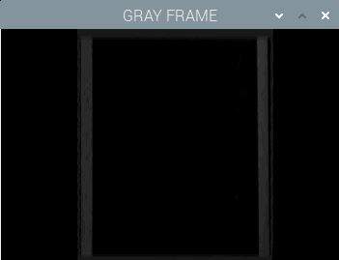
Gray Scale Image
It is a range of monochromatic shades from black to white.
Therefore, a grayscale image contains only shades of gray and no color.
Grayscale Image

Slide 14
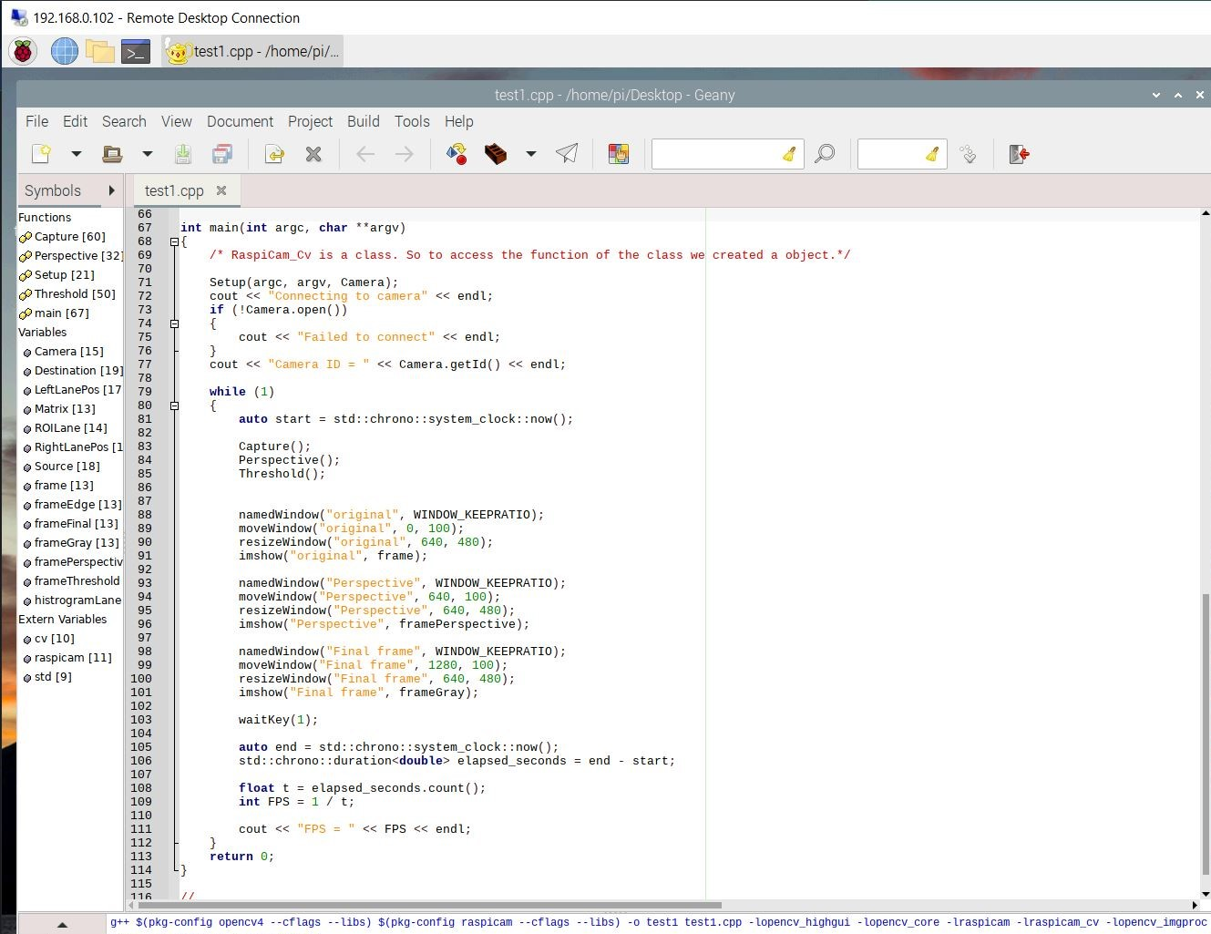

Slide 15
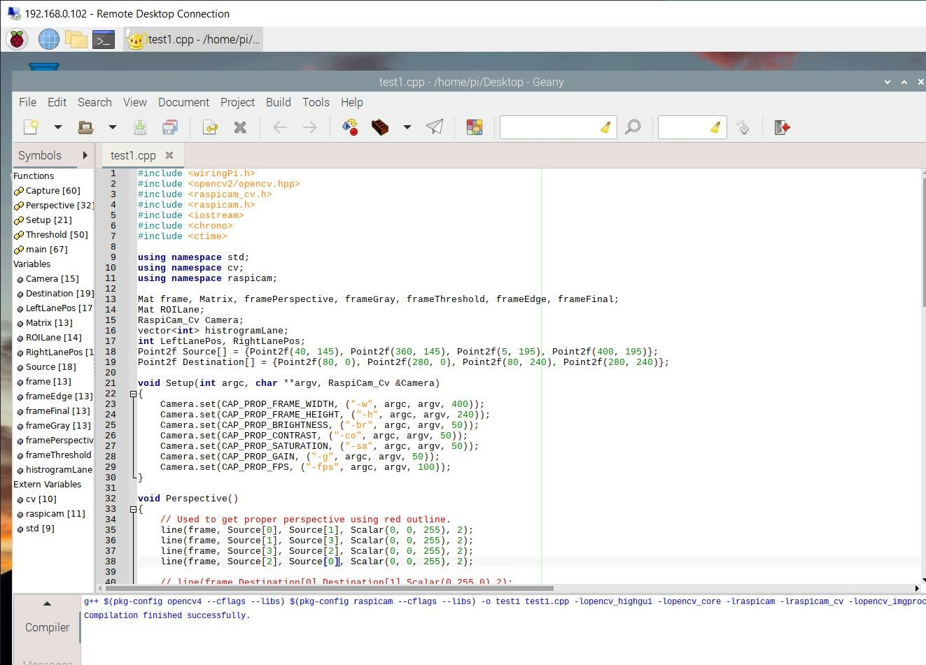

Slide 16
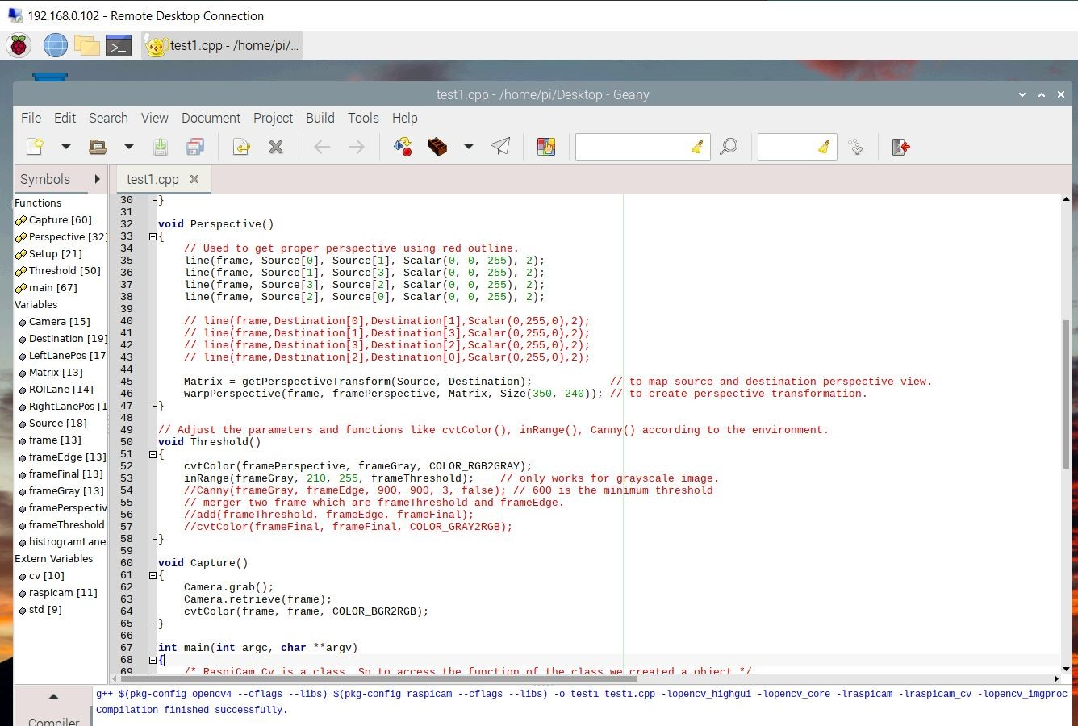

Slide 17
THANK YOU

